Slide 1
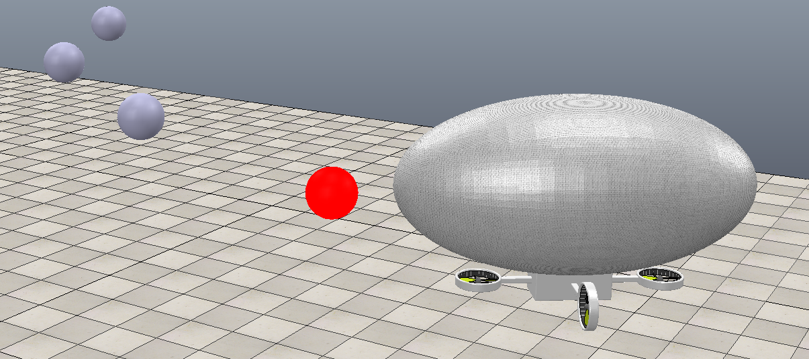
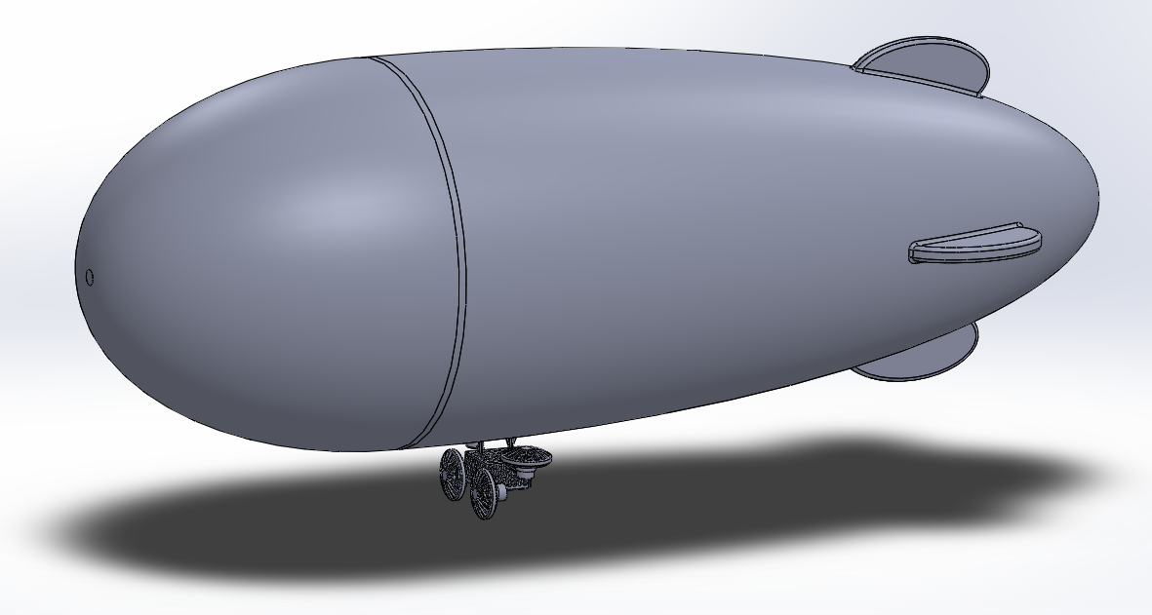
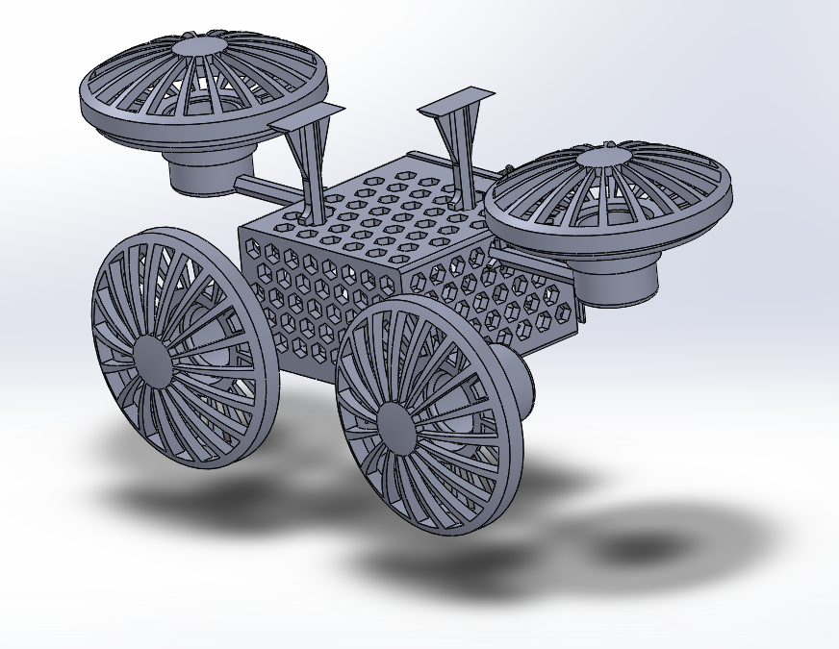
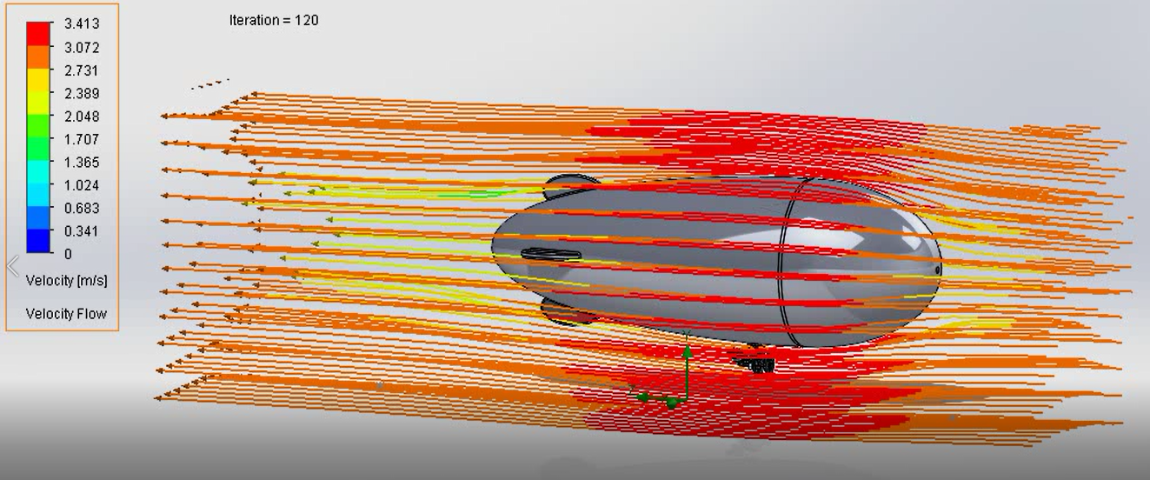
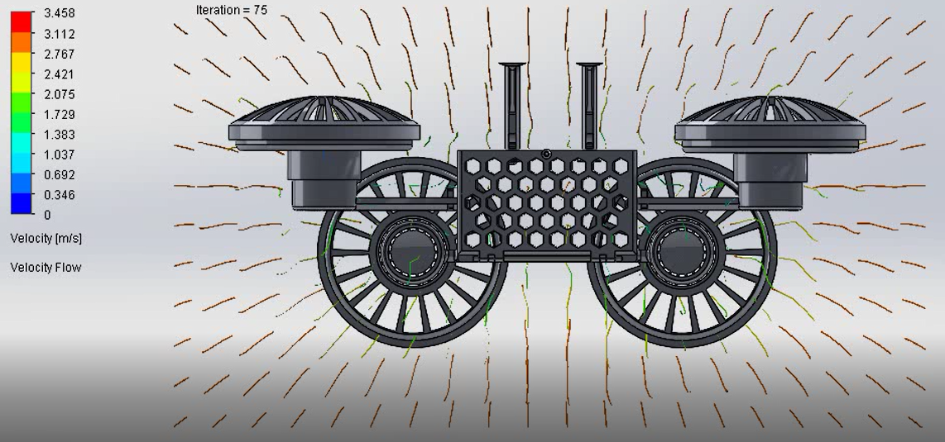
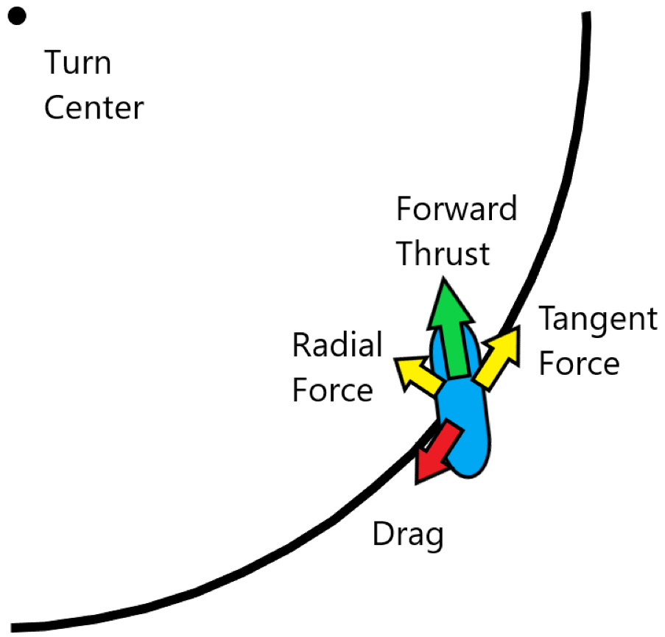
Development of an Autonomous Blimp
Ben Vu, Dylan Filkins, Jacob Thomas, Nick Short, Victor Albarran, Zeming Zhou
Portland State University and Galois Inc
INTRODUCTION:
software uses a 3D model of the blimp in addition to statistics about the blimp such as mass, buoyancy and maximum thrust to simulate the blimp moving within 3D space.
Navigation proved to be particularly difficult due to the lack of wheels or airfoils binding the velocity and heading of the blimp together. Instead, other methods were employed to recreate the forces normally provided by those features.
By oversteering through the turn, the thrust of the blimp can be used to redirect the velocity of the blimp to follow the desired curve.
The chassis and the full-scale model is illustrated below in Figure 1 & 2. The CAD design was evaluated for pressure and velocity drop across the system ( Figure 3 & 4).
consideration the defined criteria of Galois Inc. in regards to modularity, manufacturability, and protection of electrical components.
It is suggested that future evolutions are made with the combination of simulations and CAD to further refine the project. All deliverables and documentation was passed onto Galois Inc. to provide a foundation of knowledge for the next version.
The growing applications of unmanned aerial vehicles (UAV) allows for cross industry benefits. One such UAV that could see large potential in these industries are blimps. These light than air vehicles provide a large range of capabilities due to their stability and energy consumption.
Galois Inc. proposed a project in which they could use a blimp within their office environment to relay messages to coworkers and have messages forwarded. Galois Inc. saw this a benefit to communicating in the office environment in an entertaining manner.
The joint venture between the electrical and mechanical engineering departments at Portland State University collaborated to develop a simulated blimp to iteratively analyze computer aided design (CAD) models. The design process was to look at different use cases for Galois Inc. and to determine the best configuration.
*Due to the COVID-19 pandemic, the scope and possibility of constructing a physical prototype was not possible.
Figure 1: Full scale CAD model (left) and Figure 2: chassis design (right)
REFERENCES:
Tao, Qiuyang & Tan, Tun & Cha, Jaeseok & Yuan, Ye & Zhang, Fumin. (2020). Modeling and Control of Swing Oscillation of Underactuated Indoor Miniature Autonomous Blimps. Unmanned Systems. 09. 10.1142/S2301385021500060.
Jinjun Rao, et al. “A Flight Control and Navigation System of a Small Size Unmanned Airship.” IEEE International Conference Mechatronics and Automation, 2005, July 2005, doi:10.1109/icma.2005.1626776.
Zufferey, Jean Christophe et al. “Flying over the Reality Gap: From Simulated to Real Indoor Airships.” Autonomous Robots 21.3 (2006): 243–254. Autonomous Robots. Web.
Zheng, Zewei, Huo, Wei, & Wu, Zhe. (2013). Autonomous airship path following control: Theory and experiments. Control Engineering Practice, 21(6), 769–788.
Ko, Jonathan et al. “Gaussian Processes and Reinforcement Learning for Identification and Control of an Autonomous Blimp.” Proceedings - IEEE International Conference on Robotics and Automation. N.p., 2007. 742–747. Proceedings - IEEE International Conference on Robotics and Automation. Web.
Alsayed, Ahmad, and Eric Lanteigne. “Experimental Pitch Control of an Unmanned Airship with Sliding Ballast.” 2017 International Conference on Unmanned Aircraft Systems (ICUAS), 2017, doi:10.1109/icuas.2017.7991326.
Figure 3 and 4: Illustrating aerodynamics of CAD model in regards to velocity and pressure changes.
CONCLUSIONS:
The pass off of knowledge and deliverables were completed to Galoic Inc. and Portland State University to a satisfactory level. The team was able to successfully develop several simulations in the programs of CopelliaSim and WeBots to start to look at different use cases for the sponsor. Within these simulations, we were able to model a blimp to follow a path of different waypoints and to define the outside factors affecting the blimps directional path.
A refined three dimensional CAD model was produced for these simulations to see the interactions. The model considered different engineering analysis of strength, material, and aerodynamics that could affect life cycle of the chassis. The CAD model also took into consideration the defined criteria of Galois Inc. in regards to modularity, manufacturability, and protection of electrical components. he CAD model also took into
OBJECTIVE:
Create a simulation of a blimp and use the simulation to learn how blimps move, and create a chassis which can be used as a blimp gondola.
Chassis:
As part of a valuable deliverable for the sponsor a CAD design was developed to be used together with simulations. The basis of this was to be efficient with the limited time that the capstone had to evolve the simulation and design. Additionally, the simulation could provide more insights into how the chassis design would interact with the surrounding environment.
Only one chassis design was implemented due difficulties with the COVID-19 pandemic and sponsor’s interest
RESULTS:
ACKNOWLEDGEMENTS:
Simulations:
Because meeting in person was not an option, a physics simulation was employed to model the dynamics of a blimp. This gave the opportunity to visualise blimp movement and investigate navigation methods. Two softwares were used: CoppeliaSim and WeBots. Each
Special thanks for Galois Inc for sponsoring the capstone project and furthering our education through their support and dedication.
We thank professor Dr. Mark Faust for the constant assistance throughout the capstone project as well, as the electrical engineering insights to further develop our project.
We are appreciative for Dr. Marek Perkowski and Dr. Jun Jiao for their commitment in propelling our understanding of engineering topics. Through their inquisitive questions and presenting subject matter.

